Slide 1
OOP FINAL PROJECT
Submitted To:
Miss Raena Tauqir
By: Mishal Raza

Slide 2
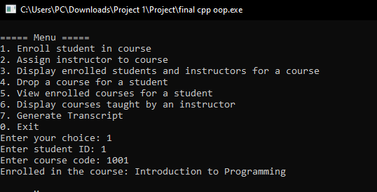
Case 1:
Enrolling Student in a Course

Slide 3
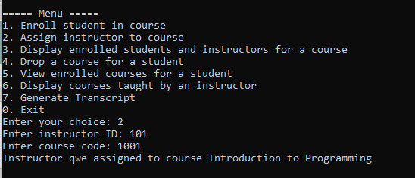
Case 2:
Assign Instructor To Course

Slide 4
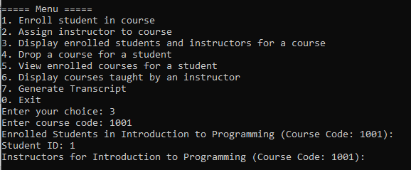
Case 3:
Display Enrolled Students and Instructors for a course

Slide 5
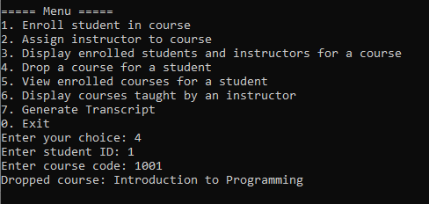
Case 4:
Drop a course for a student

Slide 6
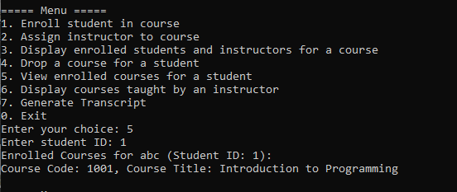
Case 5:
View Enrolled Courses for a Student

Slide 7
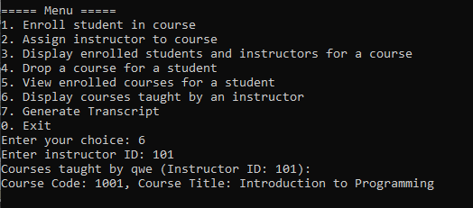
Case 6:
Display courses taught by an instructor

Slide 8
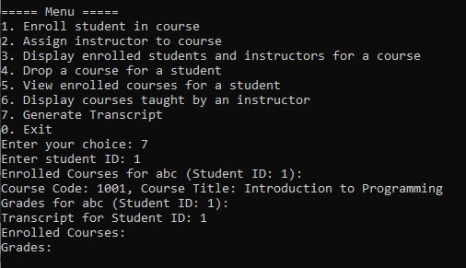
Case 7:
Generate Transcript

